Slide 1





Pie & AI: Anand
Implementation of Neural Style Transfer
Speakers:
Rakshil Kevadiya
ML Team
Jay Kshirsagar
ML Team

Slide 2

Some previous workshop’s important concepts...
Neural Network
Loss Function
Cost Function
Convolutional Neural Network

Slide 3
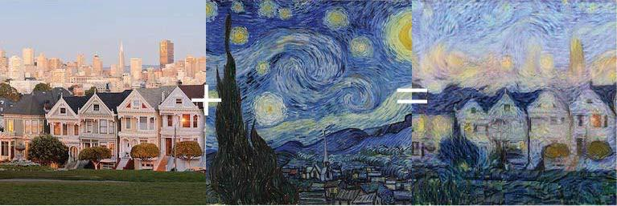
What is Neural Style Transfer?
Content + Style = Generated

Slide 4
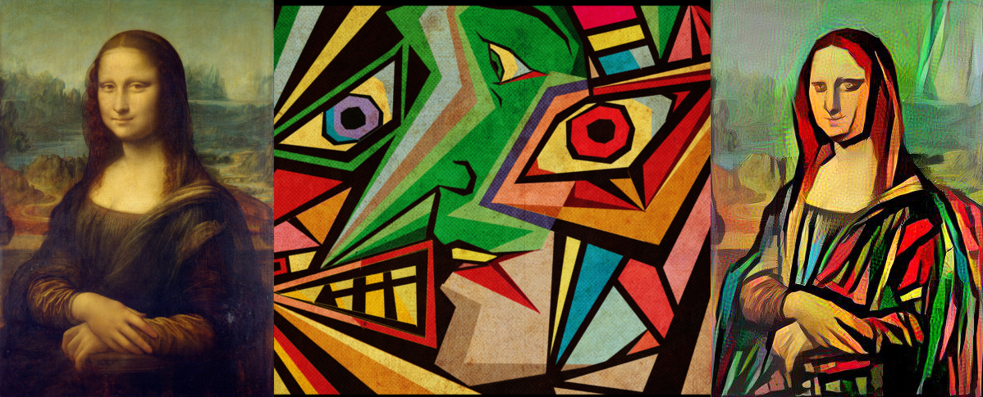
Intuition Behind NST
NST employs a pre trained convolutional neural network (CNN) to transfer styles from a given image to another. This is done by defining a loss function that tries to minimise the differences between a content image, a style image and a generated image

Slide 5
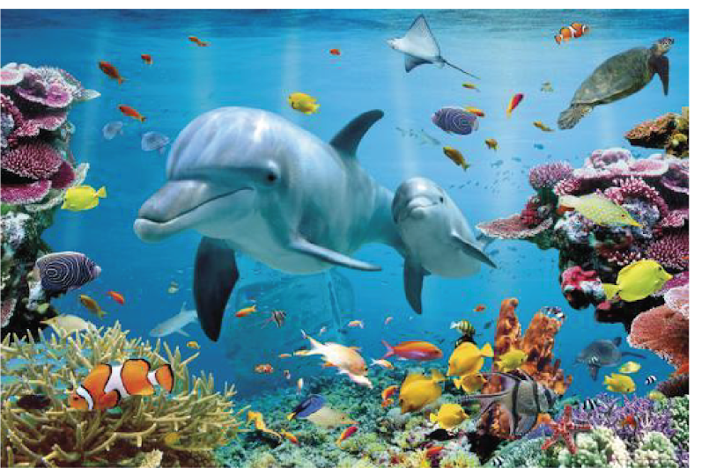
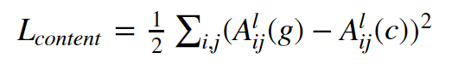
Extract content from an Image
Higher layers of a network are used for this purpose.
4th conv layer of VGG can be used as a content extractor
Content Loss:

Slide 6
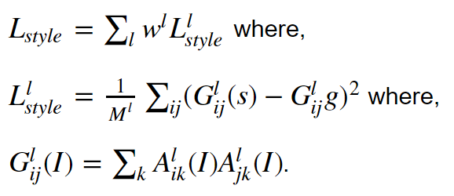
Extract Style from an Image
Capture style information but not the global representation.
Style (Colours + Texture)
Correlations between different filter responses.
This correlations among feature maps is known as gram Matrix.

Slide 7
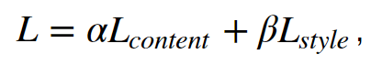
Final Loss
Content Weight: α
Style Weight: β
We can separate content and style from an image with the help of CNN.

Slide 8

Thank You!

